Slide 1
Distributed Database Systems
Autumn, 2007
Chapter 7
Decomposition and Data Localization

Slide 2
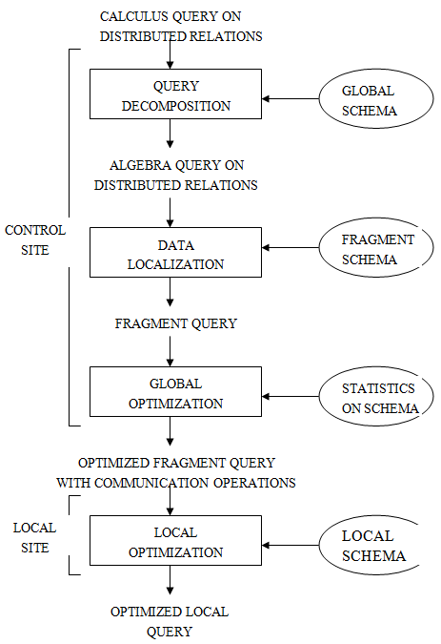
The first two layers of the laying scheme of last chapter

Slide 3
Query Decomposition

Slide 4
Overview of Query Decomposition
Four steps:
(1) normalization
(2) analysis
(3) elimination of redundancy
(4) rewriting

Slide 5
Normalization
Convert from general language to a “standard” form (e.g., Relational Algebra)
Conjunctive normal form (more practical)
Disjunctive normal form

Slide 6
Example
Select A,C
From R,S
Where (R.B=1 and S.D=2) or (R.C>3 and S.D.=2)
σ (R.B=1 v R.C>3) ∧ S.D.=2
R S
π
A, C
Conjunctive
normal
form

Slide 7
Transformation rules
1.
2.
3.
4.
5.
6.
7.
8.
9.
10.

Slide 8
Analysis
Objective
reject type incorrect or semantically incorrect queries.
Type incorrect
undefined relation, attribute, wrong type mapping etc.

Slide 9
Example
E.g.: Select * from R where R.A =3 ☒ R does not have “A” attribute
Example
SELECT E#
FROM EMP
WHERE ENAME>200
! Undefined attribute
! Type mismatch

Slide 10
Semantically incorrect
A query has some components not contributing to the query result
Fact
It’s impossible to determine the semantic correctness of a general query. But it is possible to do so for queries not containing and

Slide 11
Tool of analysis
Query graph
one node representing the result relation
other nodes to represent operand relations, and
two types of edges
an edge to represent a join if neither of its two nodes is the result
an edge to represent a projection if one of its node is the result node
Nodes and edges may be labeled by predicates for selection, projection or join.

Slide 12
Tool of analysis
Join graph
a subgraph of query graph for join operation
Example
SELECT ENAME, RESP FROM EMP,ASG,PROJ WHERE EMP.ENO=ASG.GNO AND ASG.PNO=PROJ.PNO AND PNAME=“CAD/CAM” AND DUR>36 AND TITLE=“Programmer”

Slide 13
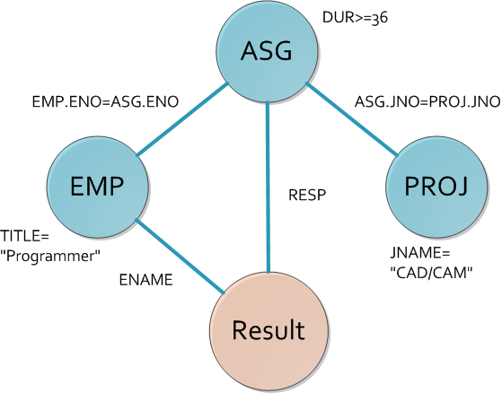
Tool of analysis
Example 1 - query graph

Slide 14
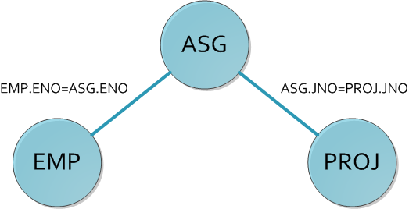
Tool of analysis
Example 1 - join graph

Slide 15
Tool of analysis
A conjunctive query without negation is semantically incorrect if its query graph is NOT connected!

Slide 16
Tool of analysis
Example 2
SELECT ENAME, RESP FROM EMP,ASG,PROJ WHERE EMP.ENO=ASG.GNO AND ASG.PNO=PROJ.PNO AND PNAME=“CAD/CAM” AND DUR>36 AND TITLE=“Programmer”

Slide 17
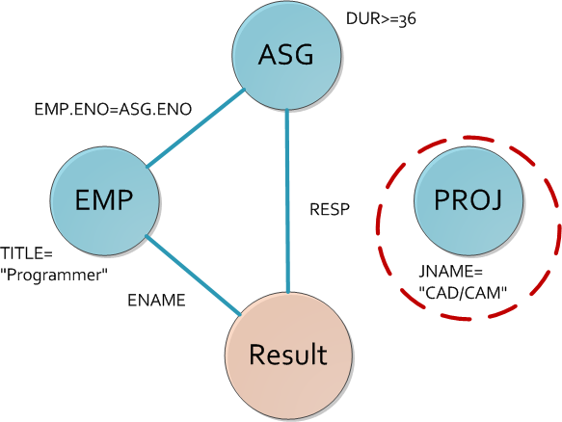
Tool of analysis
Example 2 – query graph

Slide 18
Elimination of Redundancy
E.g.: in conditions:
(S.A=1) ∧ (S.A>5) ⇒ False
(S.A<10) ∧ (S.A<5) ⇒ S.A<5
E.g.: Common sub-expressions
U U
S σcond σcond T S σcond T
R R R

Slide 19
Rules for Elimination of Redundancy

Slide 20
Exercise
Please eliminate the redundancy
SELECT TITLE
FROM EMP
WHERE (NOT(TITLE=”Programmer)
AND (TITLE=“Programmer”
OR TITLE=“Electrical Eng.”)
AND NOT (TITLE=“Electrical Eng.”))
AND ENAME=“J.Doe”
Is equivalent to
SELECT TITLE
FROM EMP
WHERE ENAME="J.Doe"

Slide 21
Rewriting
Rewrite a calculus query in relational algebra:
translation, and
reconstruction of algebra query to improve performance

Slide 22
Rewriting
Relational algebra tree - a tree defined by:
a root node representing the query result
leaves representing database relations
non-leaf nodes representing relations produced by operations, and
edges from leaves to root representing the sequences of operations

Slide 23
Rewriting
How to translate an SQL query into an algebra tree
create a leaf for every relation in the FROM clause
create the root as a project operation involving attributes in the SELECT clause
create the operation sequence by the predicates and operators in the WHERE clause

Slide 24
Rewriting Example
Example 1
SELECT ENAME
FROM PROJ, EMP, ASG
WHERE ASG.ENO=EMP.ENO
AND ASG.JNO=PROJ.JNO
AND ENAME<>“J.Doe”
AND PROJ.NAME=“CAD/CAM”
AND (DUR=12 OR DUR=24)

Slide 25
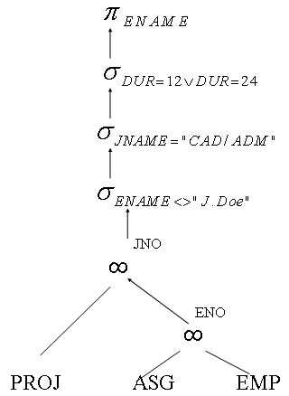
Rewriting Example
Example 1 – query tree

Slide 26
Rewriting rules for optimization
E.g.: Push conditions down
σcond3
σcond
σcond1 σcond2
R S R S

Slide 27
Rewriting rules for optimization
How to use transformation rules to optimize
separate unary operations to simplify the query expression
unary operations on the same relation may be grouped to access the same relation once
unary operations may be commuted with binary operations, so that may be performed first to reduce the size of intermediate relations
binary operations may be reordered

Slide 28
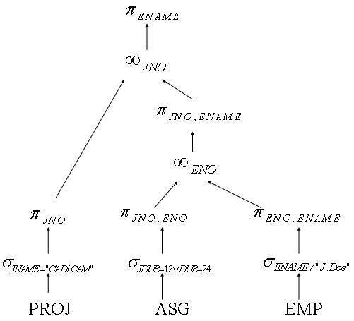
Rewriting rules for optimization
Example 2 – the optimization of previous query tree

Slide 29
Localization of Distributed Data

Slide 30
Decomposition VS. Localization
After decomposition:
One or more algebraic query trees on relations
Localization:
Replace relations by corresponding
fragments

Slide 31
Localization of Distributed Data
Objective
Translate a query on global relation into algebra queries on physical fragment, and optimize the query by reduction.
[R: cond]
fragment conditions its tuples satisfy

Slide 32
Localization Example A
(1) σE=3
R

Slide 33
Localization Example A
(2) σE=3
∪
[R1: E < 10] [R2: E ≥ 10]

Slide 34

Localization Example A
(3) ∪
σE=3 σE=3
[R1: E < 10] [R2: E ≥ 10]
$$∅$$

Slide 35
Localization Example A
(4) σE=3
[R1: E < 10]

Slide 36
Reduction for Primary Horizontal Fragmentation
Rule 1: Eliminate useless selections
σC1[R: c2] ⇒ σC1[R: c1 ∧ c2]
[R: False] ⇒ Ø

Slide 37
Reduction for Primary Horizontal Fragmentation
Example
EMP(ENO,ENAME,TITLE) is fragmented:

Slide 38
Exercise: Reduction for Primary Horizontal Fragmentation
For the fragmented EMP we have
SELECT *
FROM EMP
WHERE ENO=”E5”

Slide 39
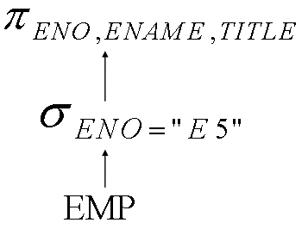
Exercise: Reduction for Primary Horizontal Fragmentation
Example 1 – Step 1
Generate a global query tree

Slide 40
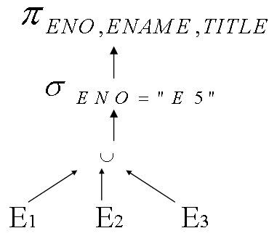
Exercise: Reduction for Primary Horizontal Fragmentation
Example 1 – Step 2
Substitute fragments for EMP

Slide 41
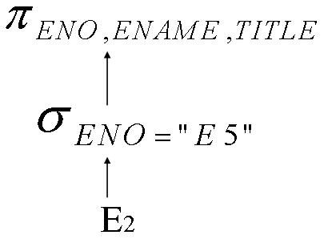
Exercise: Reduction for Primary Horizontal Fragmentation
Example 1 – Step 3
Reduction
ENO=”E5” is contradictory to ENO<=”E3” and ENO>”E6”

Slide 42
Localization Example B
(1) A=common
attribute
R S
A

Slide 43
Localization Example B
(2)
∪ ∪
A
[R1: A<5] [R2: 5 ≤ A ≤ 10] [R3: A>10]
[S1: A<5] [S2: A ≥ 5]

Slide 44
(3) ∪
[R1:A<5][S1:A<5] [R1:A<5][S2:A≥5] [R2:5≤A≤10][S1:A<5]
[R2:5≤A≤10][S2:A≥5] [R3:A>10][S1:A<5] [R3:A>10][S2:A≥5]
A
A
A
A
A
A

Slide 45
Localization Example B
(4) ∪
[R1:A<5][S1:A<5] [R2:5≤A≤10][S2:A≥5]
A
A
A
[R3:A>10][S2:A≥5]

Slide 46
Reduction for Primary Horizontal Fragmentation
Rule 2: Eliminate useless joins
[R: C1] [S: C2] ⇒
[R S: C1 ∧ C2 ∧ R.A = S.A]
A
A

Slide 47
Exercise: Reduction for Primary Horizontal Fragmentation
Example
Assume EMP is fragmented as before, and ASG is fragmented as

Slide 48
Exercise: Reduction for Primary Horizontal Fragmentation
Example
EMP and ASG are fragmented using predicates on the same attribute ENO
Query:
SELECT *
FROM EMP, ASG
WHERE EMP.ENO=ASG.ENO

Slide 49
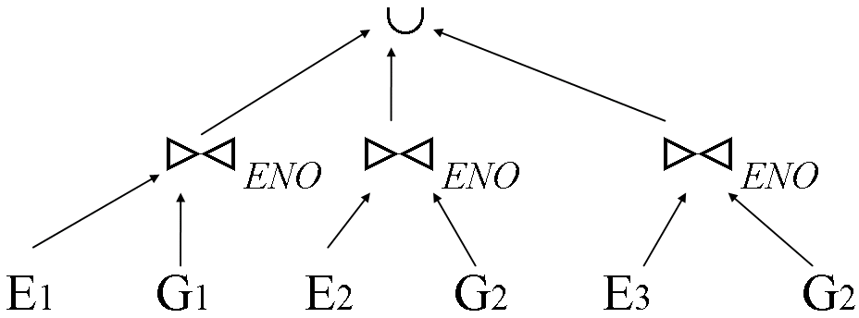
Exercise: Reduction for Primary Horizontal Fragmentation
Example
Reduced query tree

Slide 50
Localization Example C
(1) Π_{A} R1(K, A, B)
R R2(K, C, D)

Slide 51
Localization Example C
(2) Π_{A}
R1 R2
(K, A, B) (K, C, D)
K

Slide 52
Localization Example C
(3) Π_{A}
Π_{K,A} Π_{K,A}
R1 R2
(K, A, B) (K, C, D)
K
not really
needed

Slide 53
Localization Example C
(4) Π_{A}
R1
(K, A, B)

Slide 54
Reduction for Vertical Fragmentation
Rule 3: Eliminate useless joins
Given vertical fragmentation of R:
Ri = Π_{Ai} (R), Ai ⊆ A
Then for any B ⊆ A:
Π_{B} (R) = Π_{B} [ Ri | B ∩ Ai ≠ Ø ]
i

Slide 55
8.2.2 Reduction for Vertical Fragmentation
The reconstruction operation for a relation vertically fragmented is join.
Every fragment must contain the key of the relation

Slide 56
8.2.2 Reduction for Vertical Fragmentation
Example

Slide 57
8.2.2 Reduction for Vertical Fragmentation
Let R(A1,A2,An) be a relation, a vertical fragment,
Rule 3
is useless if D is not in A’.

Slide 58
8.2.2 Reduction for Vertical Fragmentation
Example
SELECT ENAME
FROM EMP

Slide 59
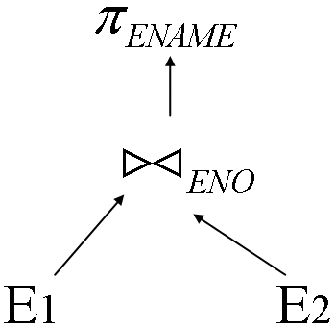
8.2.2 Reduction for Vertical Fragmentation
Example
Generic query tree

Slide 60
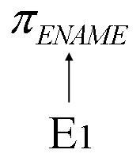
8.2.2 Reduction for Vertical Fragmentation
Example
Reduced query tree

Slide 61
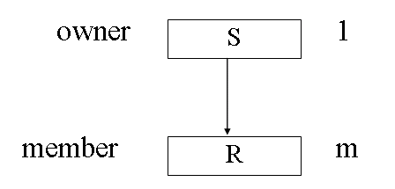
8.2.3 Reduction for Derived Fragmentation
S is primary horizontal fragmented, R is fragmented by , where A is the common attributes set, and a foreign key of R referring to S.

Slide 62
8.2.3 Reduction for Derived Fragmentation
Example
In the Engineering database ASG is fragmented based on EMP as

Slide 63
8.2.3 Reduction for Derived Fragmentation
Query optimization method
Distribute joins over unions and eliminate those useless joins due to predicate conflicts.
Example
SELECT *
FROM EMP, ASG
WHERE ASG.ENO=EMP.ENO
AND TITLE=“Mec.Eng.”

Slide 64
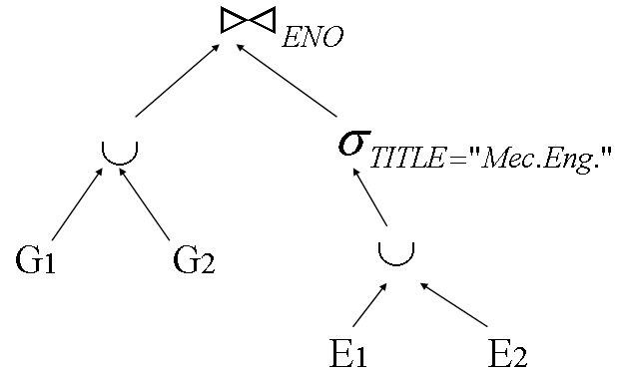
8.2.3 Reduction for Derived Fragmentation
Example
Generic query (ignoring the final projection)

Slide 65
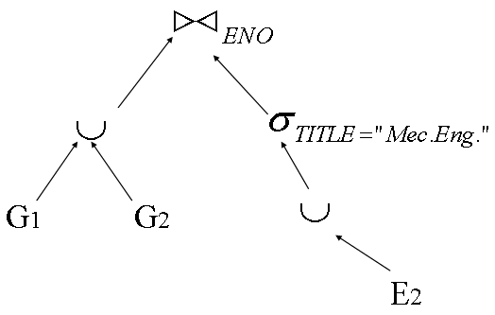
8.2.3 Reduction for Derived Fragmentation
Example
Push down and eliminate E1 as it is defined by predicate TITLE= “Programmer”.

Slide 66
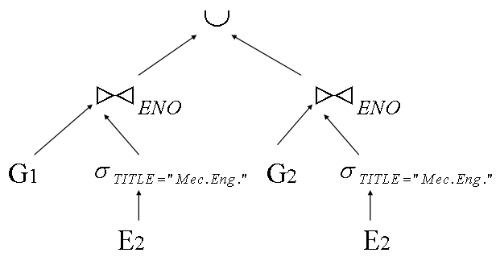
8.2.3 Reduction for Derived Fragmentation
Example
Distribute join over union

Slide 67
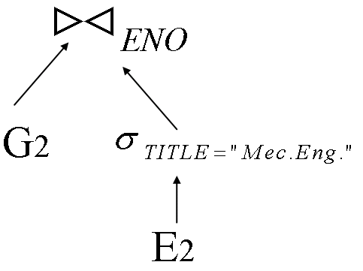
8.2.3 Reduction for Derived Fragmentation
Example
Remove the useless join (left branch of the tree) to get the best result.

Slide 68
8.2.4 Reduction for Hybrid Fragmentation
Hybrid Fragmentation
The combination of horizontal and vertical fragmentation

Slide 69
8.2.4 Reduction for Hybrid Fragmentation
Example
EMP is vertically fragmented first, and then horizontally next.

Slide 70
8.2.4 Reduction for Hybrid Fragmentation
Combine all discussed three rules to reduce hybrid fragmentation.
Example
A query on EMP fragmented as above example.
SELECT ENAME
FROM EMP
WHERE ENO=“E5”

Slide 71
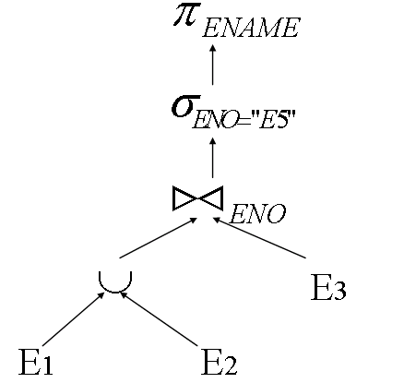
8.2.4 Reduction for Hybrid Fragmentation
Example
Generic query tree

Slide 72
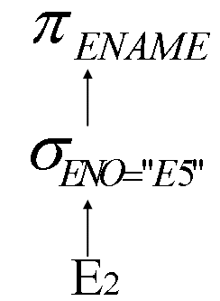
8.2.4 Reduction for Hybrid Fragmentation
Example
By rule 3, E3 is eliminated, and by rule 1, E1 is eliminated. The reduced query is

Slide 73
8.3 Conclusions

Slide 74
7.6 Conclusions
Decomposition generates algebraic queries from calculus queries. Localization express algebraic queries on fragments. An algebraic query can be optimized by transformation, heuristics, and elimination of useless operations.

Slide 75
Transformation Rules of Relational Algebra

Slide 76
Transformation Rules of Relational Algebra
Let R(A₁, A₂, …, A_{n}), S(B₁, B₂, …, B_{n}) , and T be relations

Slide 77
Transformation Rules of Relational Algebra
Commutativity of binary operations
if R and S are compatible

Slide 78
Transformation Rules of Relational Algebra
Associativity

Slide 79
Transformation Rules of Relational Algebra
Idempodance of unary operation
If
, then
If _{i}(A_{i}) is a predicate on R, then

Slide 80
Transformation Rules of Relational Algebra
Commuting σ with π
If
then the right hand side is

Slide 81
Transformation Rules of Relational Algebra
Commuting σ with binary operations
Let
be a predicate, R and T are defined on same schema

Slide 82
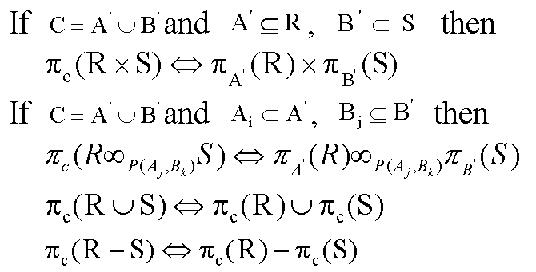
Transformation Rules of Relational Algebra
Commuting π with binary operations

